Slide 1

Patient Survival Prediction
Prof. Naila.Al-madi

Slide 2




Problem & Solution
In this presentation we present an in-depth analysis of a data set that includes patients who were admitted to an ICU, with a focus on those with the chronic condition of diabetes. We will be using the data of patients to predict if they’re going to survive the ICU admission

Slide 3

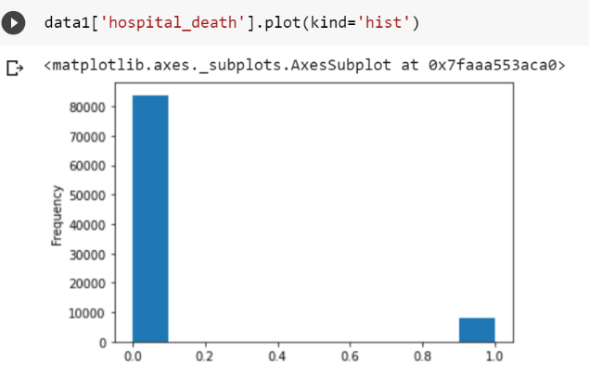
EDA
By using colab :
Checking the data types for each column and identify the target column to know our problem type (classification or regression problem).
Checking for duplicates, outliers, and missing values.
Check imbalanced data.

Slide 4

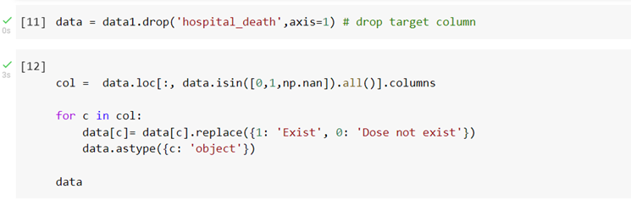
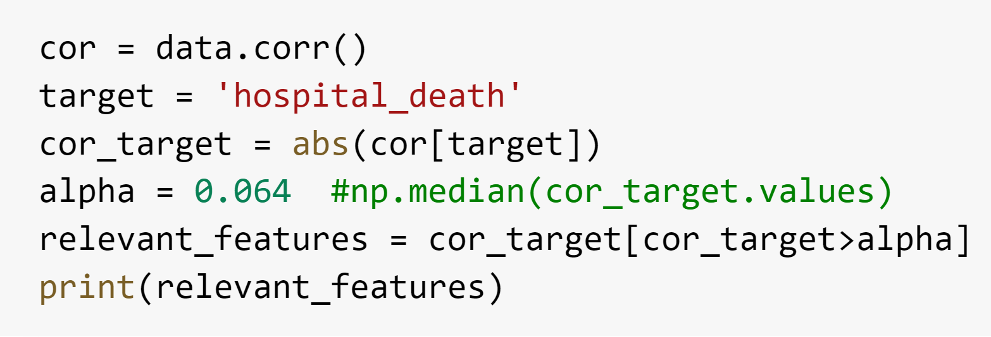
Our Process
-Data cleaning.by(Colab )
Dropped unnecessary columns.
Dropped duplicated rows.
Filled missing values.
Applied undersampling.
-Feature engineering.by (colab)
Feature scaling for numerical (standardization) and categorical (labelEncoder) columns.
Feature selection by choosing the most relevant features

Slide 5

The Models we used during our process
We used 7 different models:
XGBoost Classifier
Random Forest Classifier
K-Nearest Neighbors Classifier
Logistic Regression Classifier
Naive Bayes Classifier
Decision Tree Classifier
Support Vector Machine Classifier
Artificial Neural Networks Classifier ANN
Model performance evaluation measures table :

Slide 6
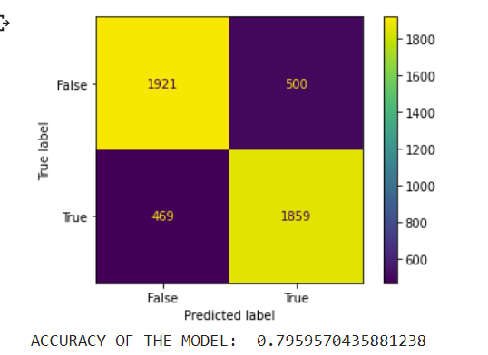
XGBoost Classifier
XGBoost Classifier model
achieved the highest overall performance among the eight models.
ACCURACY OF THE MODEL: 0.796

Slide 7
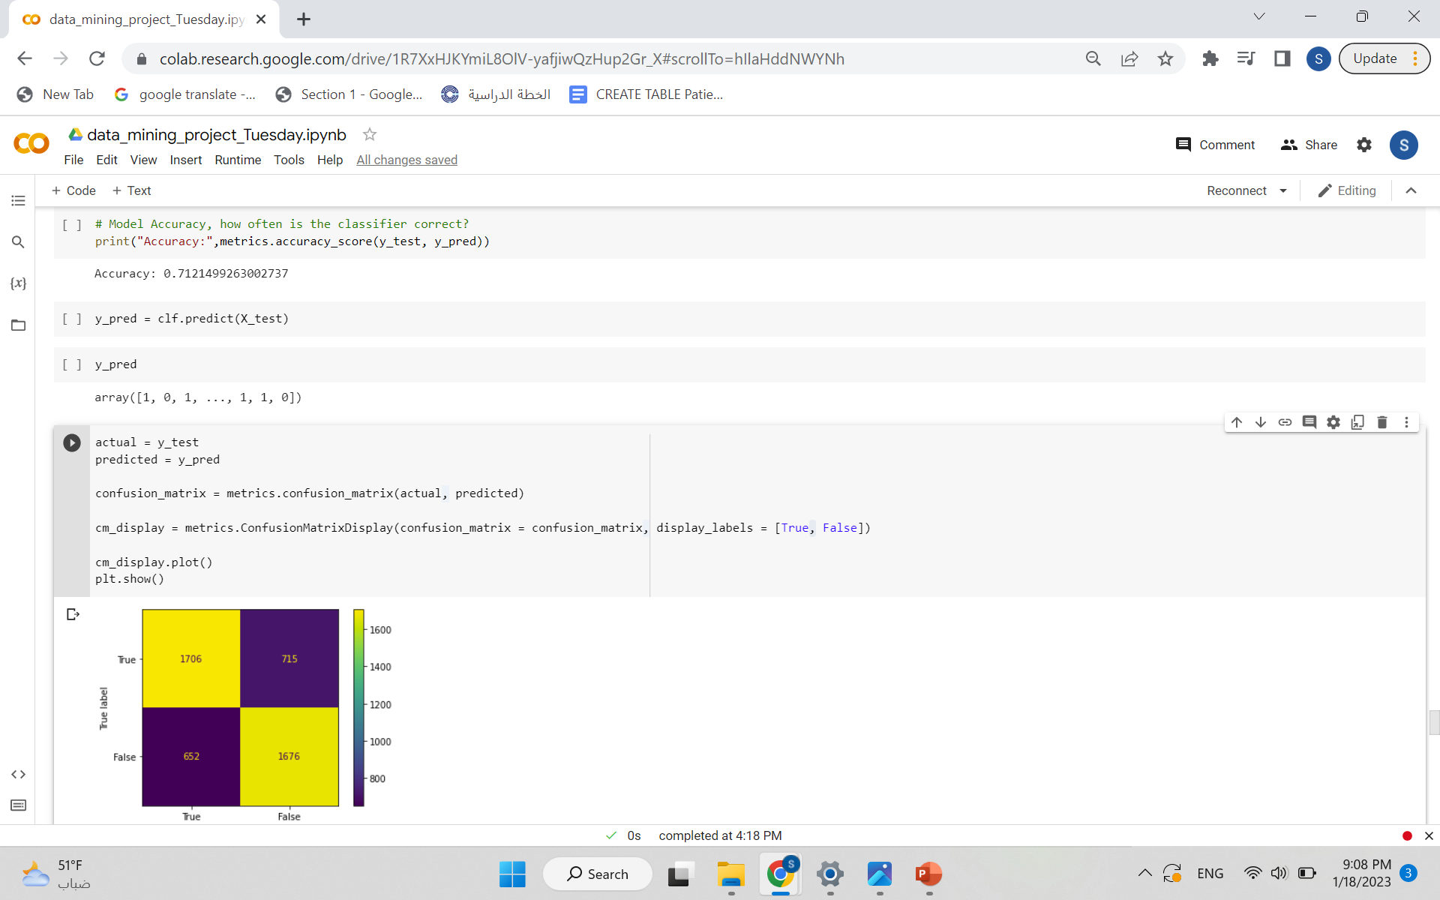
Decision Tree Classifier
The lowest overall performance was the Decision Tree Classifier
with an accuracy of: 0.71

Slide 8
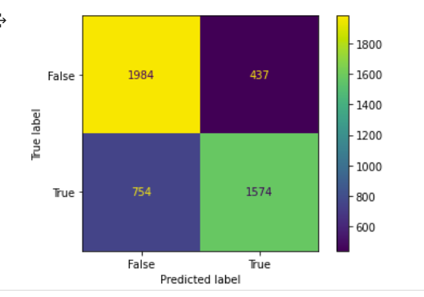

Naive Bayes Classifier:
And in between these accuracies ..we used Naïve Bayes Classifier
with Accuracy of
0.75

Slide 9

Summary Eight different machine learning models were trained and evaluated on the cleaned data set. The results show that the XGBoost classifier model achieved the highest overall performance, with an accuracy measure of 80%. The lowest overall performance was the Decision Tree Classifier with an accuracy of 71%.

Slide 10


Thank You
Team 2

